Slide 1
Cache-Conscious Runtime Optimization for Ranking Ensembles
Xun Tang, Xin Jin, Tao Yang
Department of Computer Science
University of California at Santa Barbara
SIGIR’14

Slide 2
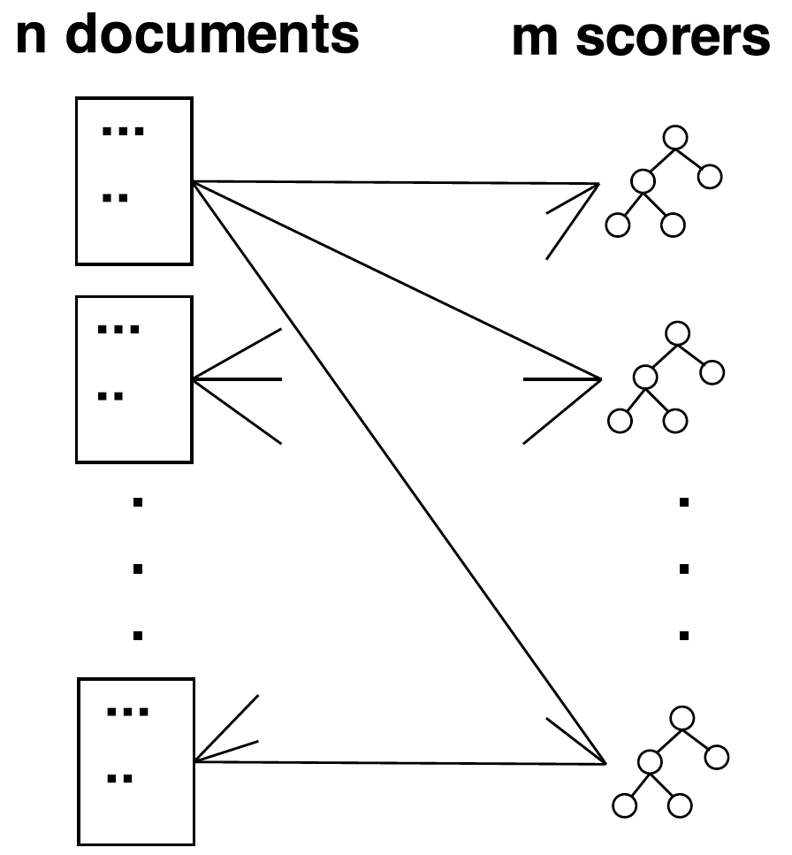
Focus and Contributions
Challenge in query processing
Fast ranking score computation without accuracy loss in multi-tree ensemble models
Contributions
Investigate data traversal methods for fast score calculation with large multi-tree ensemble models
Propose a 2D blocking scheme for better cache utilization with simple code structure
Notes:
How to efficiently rank? Look at the ranking phase (not modeling), where scorers have been trained, and calculate a score per doc per scorer.
--
How can fast multi-tree ensemble ranking with simple code structure be accomplished
via memory hierarchy optimization, without compromising ranking accuracy?
Experiments with several benchmarks show significant acceleration in score calculation without loss of ranking accuracy.

Slide 3
Motivation
Ranking assembles are effective in web search and other data applications
E.g. GBRT
A large number of trees are used to improve accuracy
Winning teams at Yahoo! Learning-to-rank challenge used ensembles with 2k to 20k trees, or even 300k trees with bagging methods
Time consuming for computing large ensembles
Access of irregular document attributes impairs CPU cache reuse
Unorchestrated slow memory access incurs significant cost
Memory access latency is 200x slower than L1 cache
Dynamic tree branching impairs instruction branch prediction
Notes:
Why is this a problem? Can not fit all doc or all scorers in cache, periodically bringing them back from memory costs time.
--
Parallelization does not help increase query process throughput

Slide 4
Previous Work
Approximate processing: Tradeoff between ranking accuracy and performance
Early exit [Cambazoglu et al. WSDM’10]
Tree trimming [Asadi and Lin, ECIR’13]
Architecture-conscious solution
VPred [Asadi et al. TKDE’13]
Convert control dependence to data dependence
Loop unrolling with vectorization to reduce instruction branch misprediction and mask slow memory access latency
Notes:
Compact: fewer nodes, fewer branch instructions. Shallow: tree depth not deep, longest path thru the tree is bounded; balanced: shorter avg. paths thru the tree, less variance on execution time
Early exit: stop when it is impossible for a doc’s additive result to be top-k
Tree trimming: directly modify splitting criterion; prune trees between boosting stages
Vpred: avoid jumping in assembly code (control prediction more likely to be correct); pipelining / process a vector of tuples at a time.
Weakness it has not fully exploited cache capacity for better temporal locality.
Another weakness is that the length of the unrolled code is quadratic to the maximum tree depth in a ensemble,
and linear to the vectorization degree v.
Our proposed technique is complementary to previous work

Slide 5
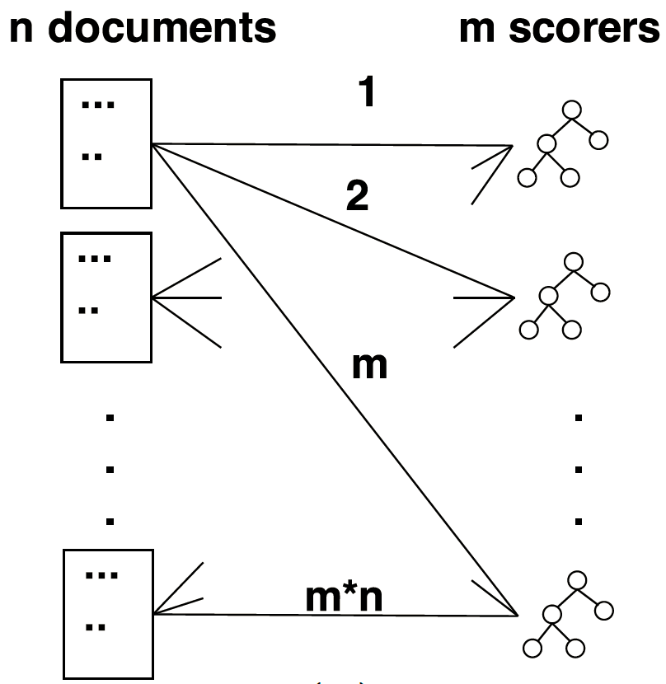
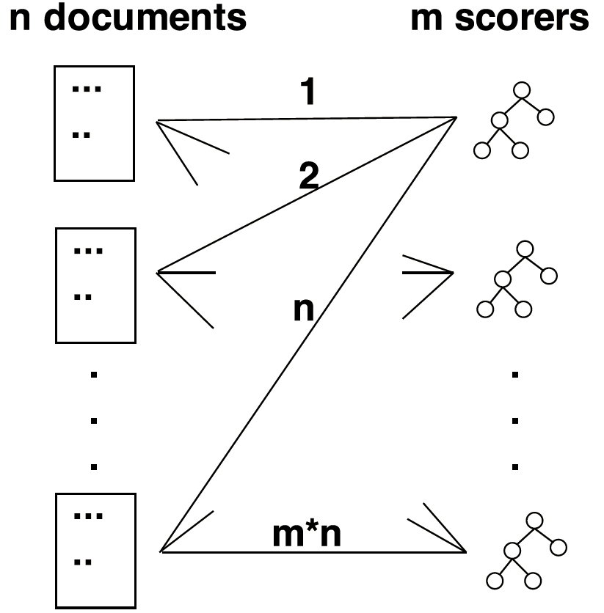
Document-ordered Traversal (DOT)
Our Key Idea: Optimize Data Traversal
Two existing solutions:
Scorer-ordered Traversal
(SOT)
Notes:
Dot: every time bring a doc from mem to cache, benefits m scorers. So instead of bringing in n*m times, only bring in n*m/m=n times.

Slide 6
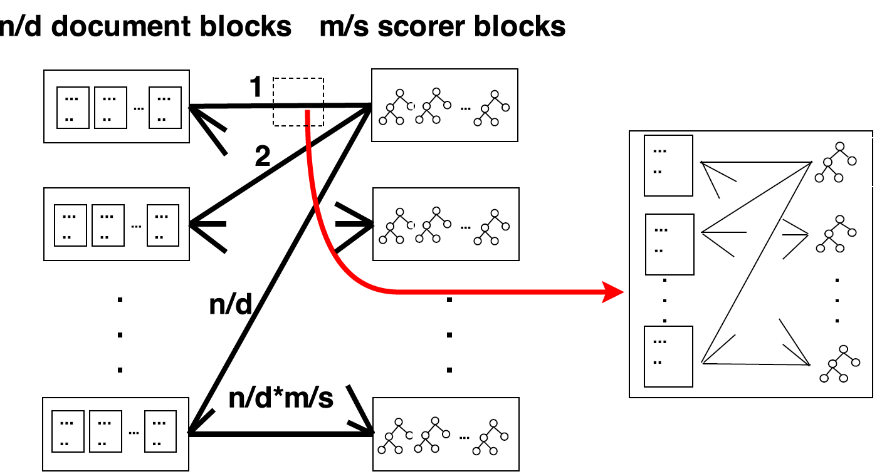
Our Proposal: 2D Block Traversal
Notes:
Each time bring in a scorer, benefit d docs for n/d blocks, so benefit n docs. Instead of bring in scorer n*m times, actually bring in n*m/n=m times.
Each time bring in a doc, benefit s scorers. Instead of bring in docs n*m times, actually bring in n*m/s times.

Slide 7
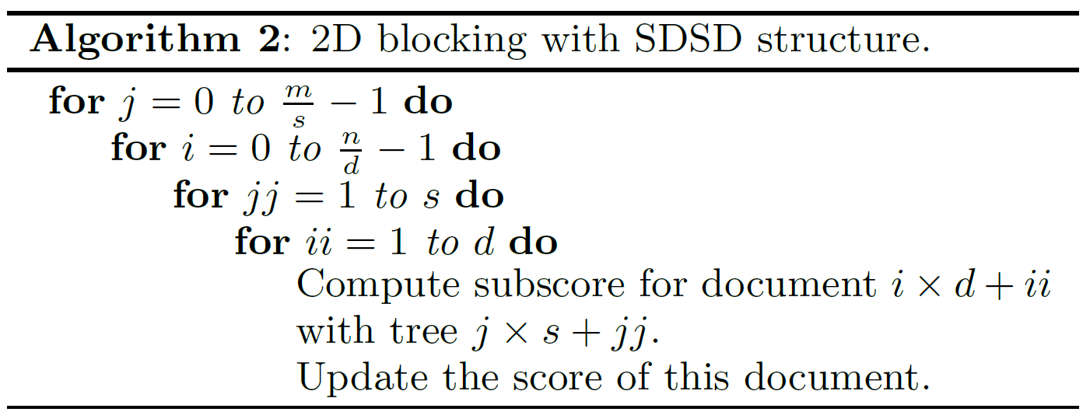
Algorithm Pseudo Code

Slide 8
Why Better?
Total slow memory accesses in score calculation
2D block can be up to s time faster. But s is capped by cache size
DOT | SOT | 2D Block
2D Block fully exploits cache capacity for better temporal locality
Block-VPred: a combined solution that applies 2D Blocking on top of VPred
Notes:
Simplified Cache Performance Analysis

Slide 9
Evaluations
2D Block and Block-VPred implemented in C
Compiled with GCC using optimization flag -O3
Tree ensembles derived by jforests [Ganjisaffar et al. SIGIR’11] using LambdaMART [ Burges et al. JMLR’11]
Experiment platforms
3.1GHz 8-core AMD Bulldozer FX8120 processors
Intel X5650 2.66GHz 6-core dual processors
Benchmarks
Yahoo! Learning-to-rank, MSLR-30K, and MQ2007
Metrics
Scoring time
Cache miss ratios and branch misprediction ratios reported by Linux perf tool
Notes:
We synthetically generate more matched document vectors for each query. Among these synthetic vectors, we generate more vectors bear similarity to those with low labeled relevance scores, because typically the majority of matched results are less relevant.

Slide 10
Scoring Time per Document per Tree in Nanoseconds
Query latency = Scoring time * n * m
n docs ranked with an m-tree model

Slide 11
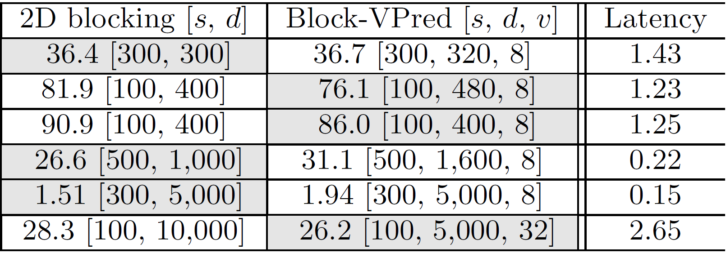
Query Latency in Seconds
Fastest algorithm is marked in gray.
2D blocking
Up to 620% faster than DOT
Up to 213% faster than SOT
Up to 50% faster than VPred
Block-VPred
Up to 100% faster than VPred
Faster than 2D blocking in some cases
Notes:
MQ2007 200 leaves DOT 204 vs. 2D Block 28.3 → 621%
Yahoo 50 leaves SOT 113.8 vs. 2D Block 36.4 → 213%
Yahoo 150 leaves Vpred 123 vs. 2D Block 81.9 → 50%

Slide 12
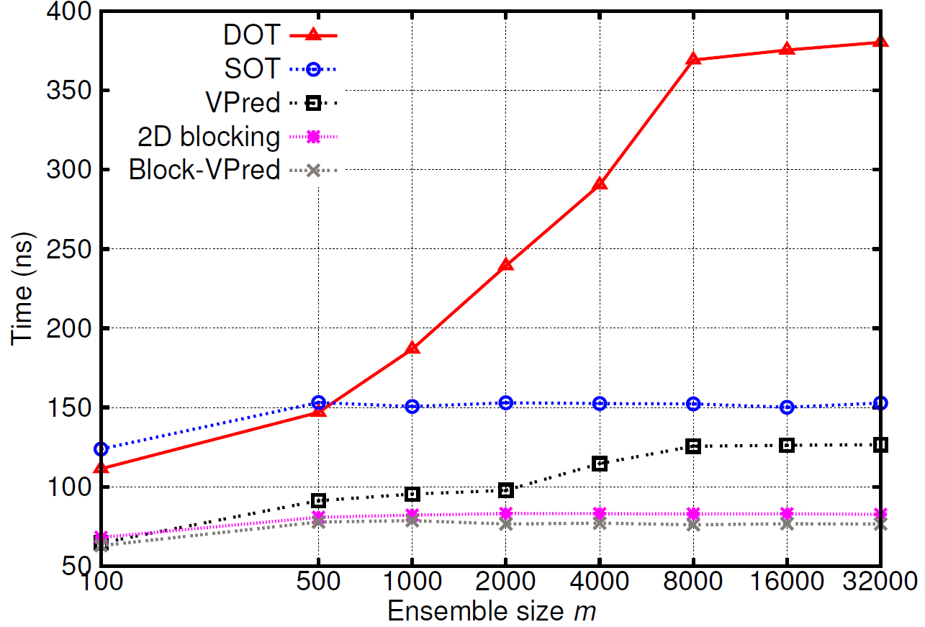
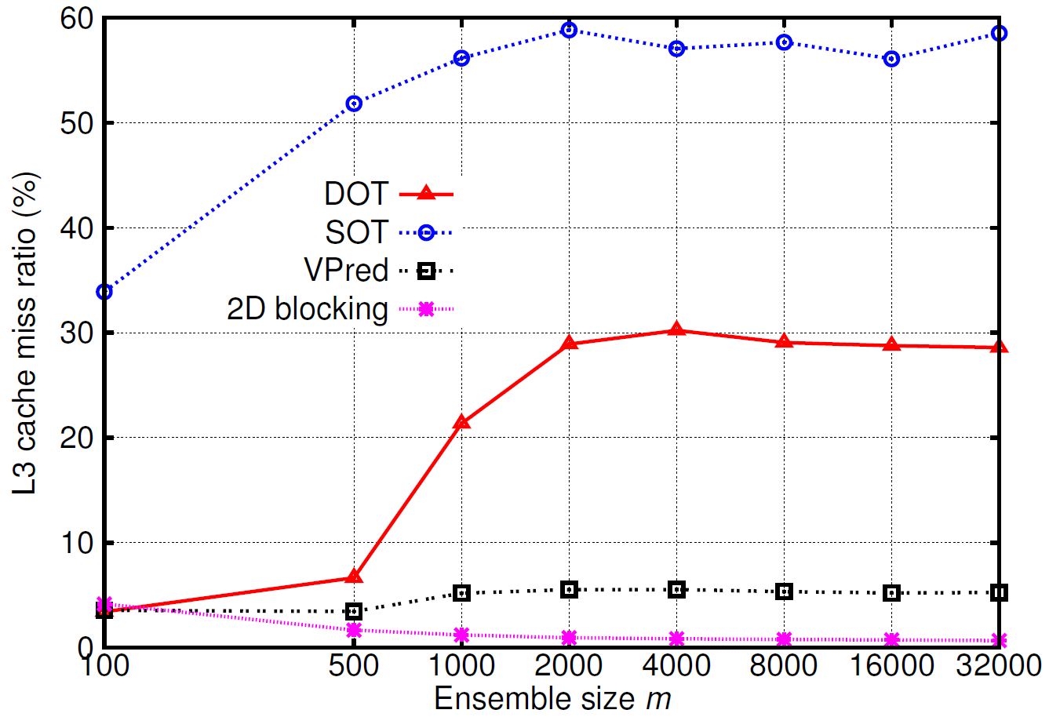
Time & Cache Perf. as Ensemble Size Varies
2D blocking is up to 287% faster than DOT
Time & cache perf. are highly correlated
Change of ensemble size affects DOT the most
Notes:
Dot suffer more branch mispredictions than sot, hence it is slower given the same cache miss ratios.
M=32k, DOT 320.3 vs. 2D Block 82.7 vs. Block-Vpred 76.6
n is fixed as 2,000
1. DOT scoring time and L3 cache miss both rise dramatically when ensemble size increases & trees do not fit in cache
2. Performance of Block-VPred and 2D blocking is close, barely affected by the change of ensemble size
3. SOT has a visibly higher miss ratio because it needs to bring back most of the documents from memory to L3 cache every time it evaluates them against a scorer
--
L3 miss ratio denotes among all the references to L3 cache, how many are missed and need to be fetched from memory.

Slide 13
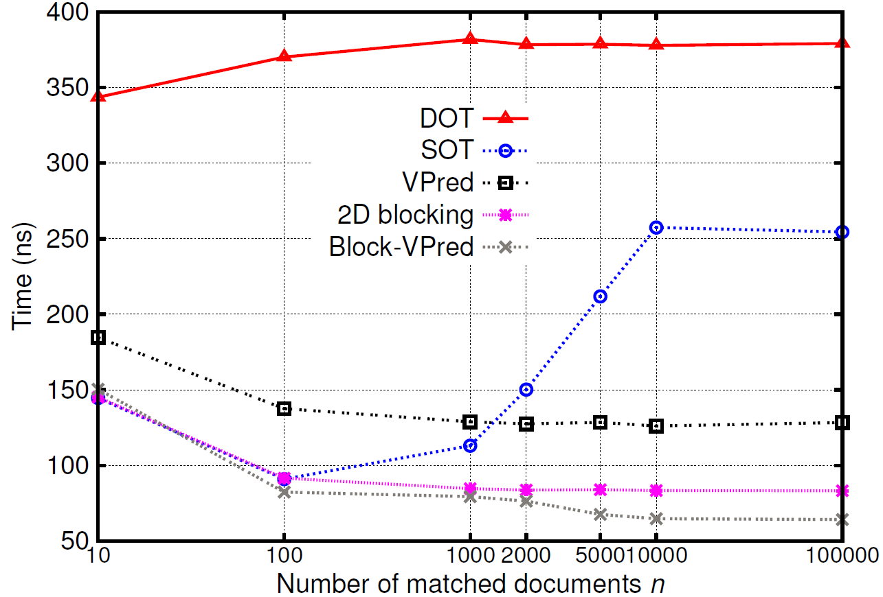
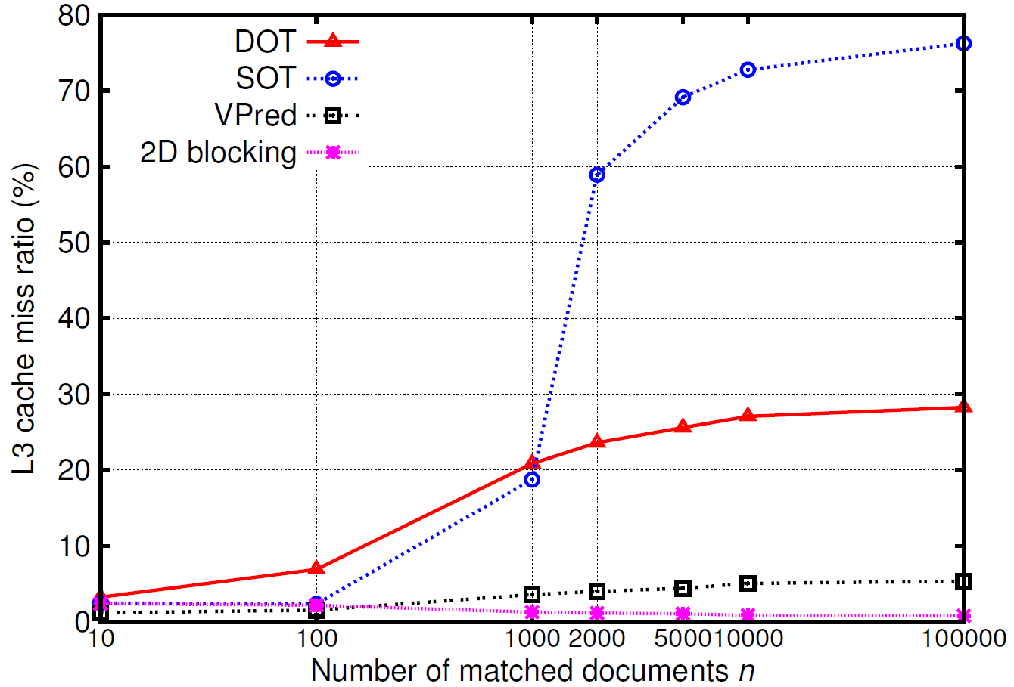
Time & Cache Perf. as No. of Doc Varies
2D blocking is up to 209% faster than SOT
Block-VPred is up to 297% faster than SOT
SOT deteriorates the most when number of doc grows
2D combines the advantage of both DOT and SOT
Notes:
Yahoo 150 leaves n=10k
DOT 377.8 vs. SOT 257.4 vs. VPred 126.1 vs. 2D Block 83.4 vs. Block-Vpred 64.8
m is fixed as 8,051
1. SOT scoring time and L3 cache miss ratio deteriorate significantly when increases number of documents & documents cannot fit in cache any more
2. Block-VPred and 2D blocking are unaffected by the change of number of documents

Slide 14
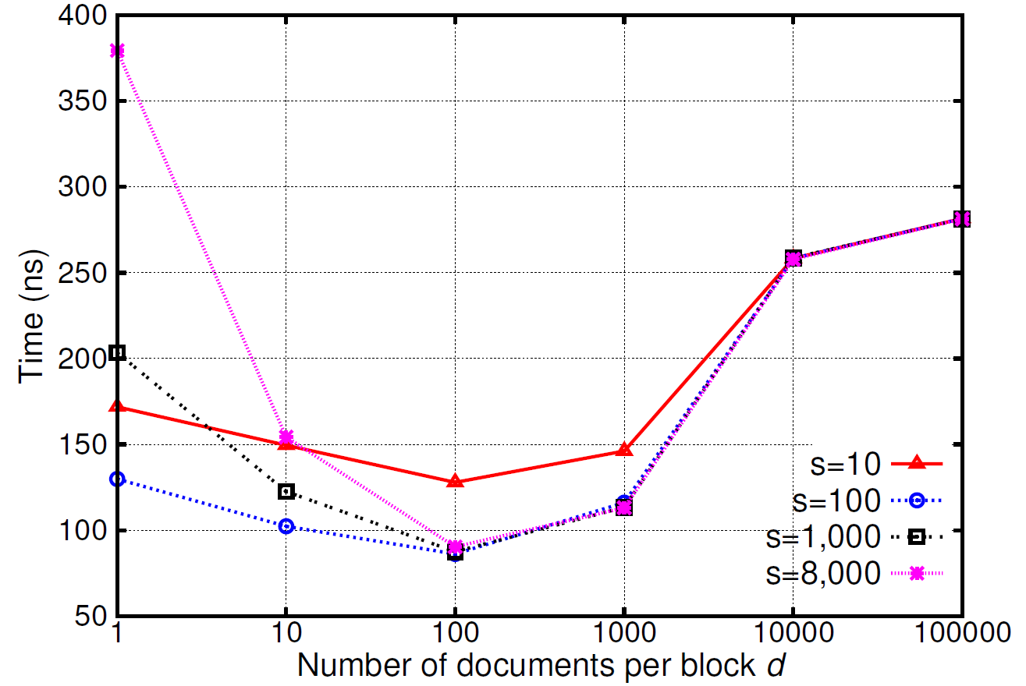
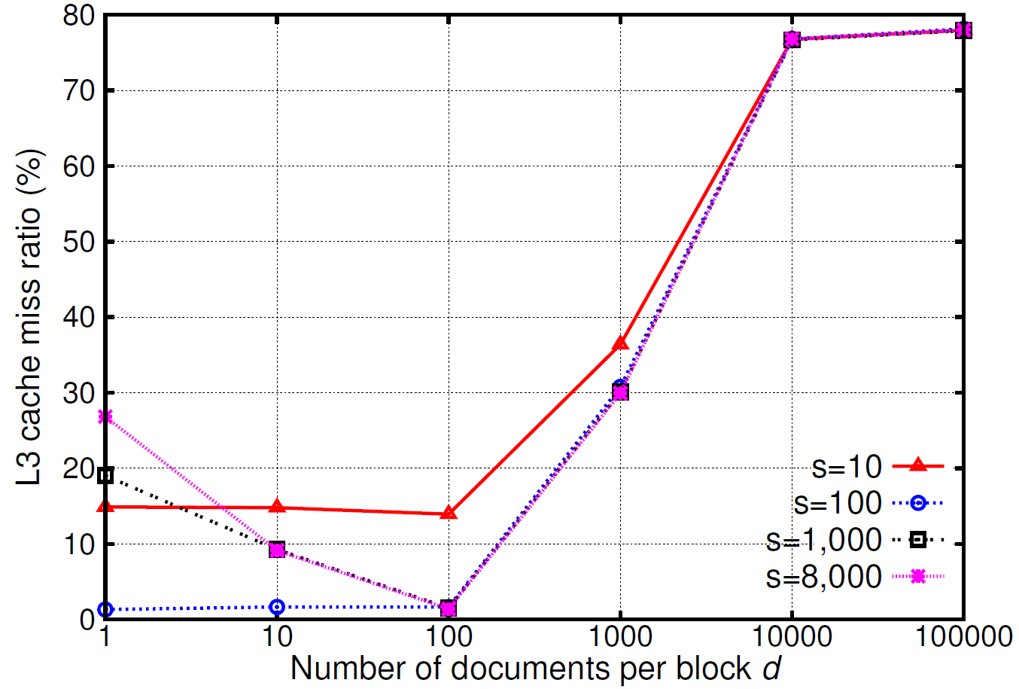
2D Blocking: Time & Cache Perf. as Block Size Vary
The fastest scoring time and lowest L3 cache miss ratio are achieved with block size s=1,000 and d=100 when these trees and documents fit in cache
Scoring time could be 3.3x slower if block size is not chosen properly
Notes:
When s=1,000, miss ratio varies from 1.64% (d=100) to 78.1% (d=100,000). As a result, scoring time increases from 86.2ns to 281.5ns.
Less affected by s, more affected by choice of d. Because docs is the inner most loop, and been hit most frequently in cache.

Slide 15
Impact of Branch Misprediction Ratios
MQ2007 Dataset | DOT | SOT | VPred | 2D Block | Block-VPred
50-leaf tree | 1.9% | 3.0% | 1.1% | 2.9% | 0.9%
200-leaf tree | 6.5% | 4.2% | 1.2% | 9.0% | 1.1%
Yahoo! Dataset | n=1,000 | n=5,000 | n=10,000 | n=100,000
2D Block | 1.9% | 2.7% | 4.3% | 6.1%
Block-VPred | 1.1% | 0.9% | 0.84% | 0.44%
For larger trees or larger no. of documents
Branch misprediction impacts more
Block-VPred outperforms 2D Block with less misprediction and faster scoring
Notes:
In other cases, the benefit of converting control dependence as data dependence does not outweigh the overhead introduced.

Slide 16
Discussions
When multi-tree score calculation per query is parallelized to reduce latency, 2D blocking still maintains its advantage
For small n, multiple queries could be combined to fully exploit cache capacity
Combining leads to 48.7% time reduction with Yahoo! 150-leaf 8,051-tree ensemble when n=10
Future work
Extend to non-tree ensembles by iteratively selecting a fixed number of base rank models that fit in fast cache
Acknowledgments
U.S. NSF IIS-1118106
Travel grant from ACM SIGIR

